Slide 1
3.1 Simple Linear Regression
October 24, 2014

Slide 2
Linear Regression
Supervised learning
Useful for predicting a quantitative response
Examples:
Is there a relationship between budget and sales?
Which media contribute to sales?
Are these relationships linear?
Other examples?

Slide 3

Simple Linear Regression
Predicting quantitative Y based on a single predictor X
Intercept
Slope
β_{o} and β₁ = Model Coefficients/Parameters
Unknown

Slide 4

Simple Linear Regression
We can use the training equation to produce estimates for β_{o} and β₁ and then can predict future outcomes (Y) using this equation:

Slide 5
Estimating the Coefficients
We want to estimate the slope and intercept so it is close as possible to the “true” data or outcome
Using advertising dataset with 200 different markets
Budget
Product sales
Want to obtain coefficient estimates so that the linear model fits the data well and approximates the data well
Most common approach is to minimize the least squares

Slide 6


Residual Sum of Squares
Prediction for Y based on the ith value of X
e is the difference between ith observed response and the ith value that is predicted by the mode (Residual)

Slide 7
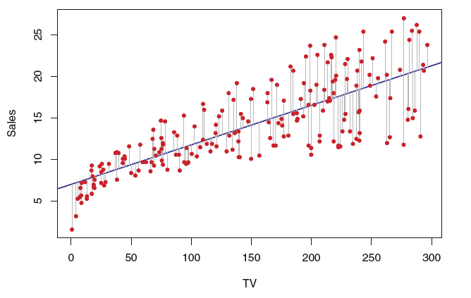
Least Squares to minimize the RSS

Slide 8

Accuracy of Coefficient Estimates
True Relationship between X and Y
For an unknown function (f) where e is a mean-zero random error
For f to be estimated by a linear function:
βo (intercept) = expected Y when X=0
β1 (slope) = average increase in Y with a 1-unit increase in X
Population Regression Line:

Slide 9
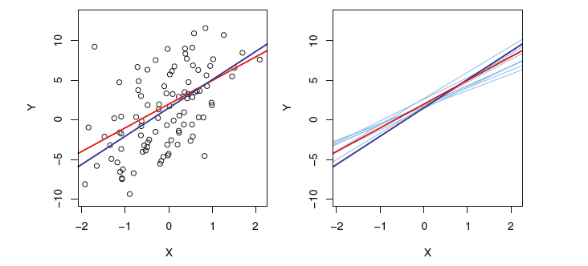

Red Line = True Relationship f(X) = 2 + 3X (population regression line)
Dark Blue = Least Squares Line
Right Graph = light blue lines that represent 10 different least squares
(on average the least squares are close to the population regression line)

Slide 10



Standard Error and Confidence Intervals
Standard Error: Difference between the population mean and the estimate of the population mean
95% Confidence Intervals: A range that with 95% probability will be a true estimate of a parameter
Slope
Intercept

Slide 11
Hypothesis Testing
Standard errors can be used to perform hypothesis tests
Null Hypothesis: Ho: β1 = 0
no relationship between X and Y
Alternative Hypothesis: H1: βo ≠ 0
Some relationship between X and Y

Slide 12

Hypothesis Testing
When β1 = 0 the model reduces to Y = βo + ε (X is not associated with Y)
How do we know the β1 is “far” from zero so we are confident that it is NOT zero?
T-statistic: number of standard deviations the estimate of β1 is away from zero
P-value: the probability of observing any value = |t| assuming β1 = 0

Slide 13

Final Model from Advertising Data
Least Squares Model: the number of units sold with the TV advertising budget
Coefficients of estimates: β0 = 7 and βo = 0.05 are large compared to the Std Error
Large difference between estimates and std error = large t-statistic
Therefore, we can reject the null hypothesis that βo = 0 or β1 = 0

Slide 14
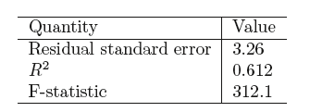
Assessing model accuracy

Slide 15
Assessing model accuracy
Residual standard error (RSE): average amount the response will deviate from the true regression line
Up to the scientist to decide whether the deviation is acceptable
In the case of our advertising example the RES = 3.26 or 3,260 units. Is this ok?
R² statistic: proportion of variance explained by the model
Will always be between 0 and 1
Proportion of variability in Y that can be explained by X
Advertising data: R2 is 0.61, is this ok?
Notes:
In the advertising data the mean value is 14,000 so our RSE is 23% of that. It’s a measure of a lack of model fit.
R-squared. A number closer to 1 indicates a large proportion of variability in Y has been explained by X
R squared is a measure of the linear relationship between X and Y

Slide 16
Lab
Boston dataset
Median house value (medv) for 506 neighborhoods in Boston
Predict medv using 13 different variables
Rm: average number of rooms per house
Age: average age of house
Lstat: percent of households with low SES

Slide 17
Lab: relationship between medv and lstat
Coefficients:
Estimate Std. Error t value Pr(>|t|)
(Intercept) 34.55384 0.56263 61.41 <2e-16 ***
lstat -0.95005 0.03873 -24.53 <2e-16 ***
Residual standard error: 6.216 on 504 degrees of freedom
Multiple R-squared: 0.5441, Adjusted R-squared: 0.5432
F-statistic: 601.6 on 1 and 504 DF, p-value: < 2.2e-16
Notes:
So this means both of our estimates are significant so we are rejecting the Null. For increases in median household value the percent of households with low SES goes down. Makes sense
RSE = 6.2 which says our estimate will deviate by 6.2 from the true regression line.
The R squared is 0.5 which means we are explaining about 50% of the variance between lstat and medv using this model
So are these good or not? Lets take a look.

Slide 18
Prediction of the relationship using different values of lstat
fit (prediction) lwr upr
5: 29.80359 29.00741 30.59978
10: 25.05335 24.47413 25.63256
15: 20.30310 19.73159 20.87461

Slide 19
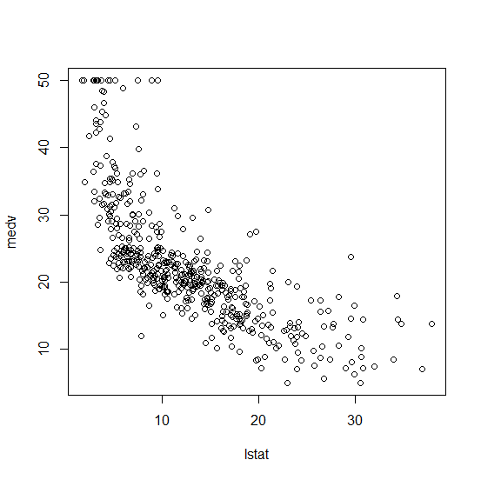
Relationship between medv and lstat

Slide 20
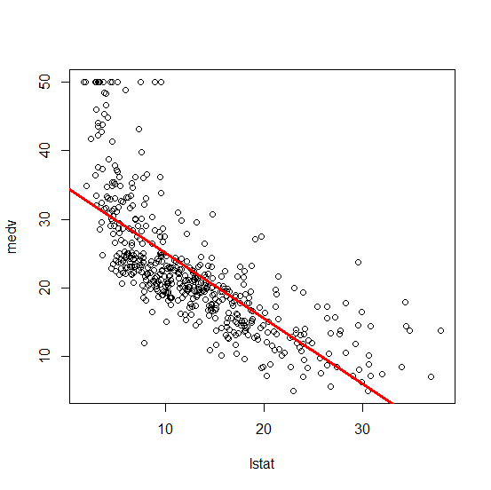
Medv and Lstat with a regression line

Slide 21
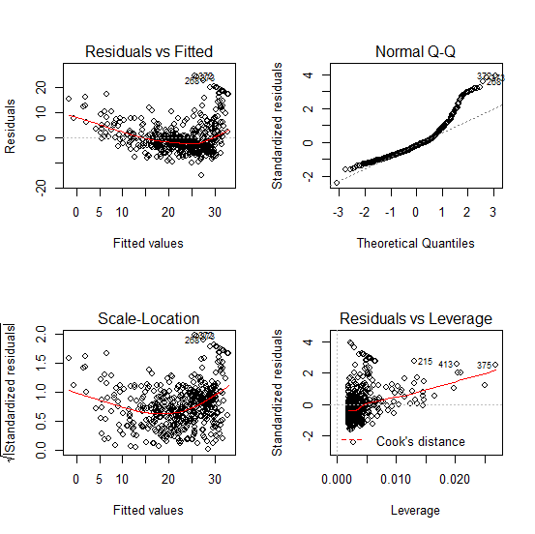
Evidence of non-linearity in the relationship

